Slide 1
Data analysis using power BI
Team Members:
KANIGICHERLA VENKATA KRISHNA SAMPATH(RA2011042010047)
B.ASRITH GANESH(RA2011042010025)
LALITH MUTTINENI(RA2011042010061)

Slide 2
Description:
Computer manufacturing company’s are facing lot’s of problems due to market is growing in dynamically (forces that will impact prices and the behaviours of producers and consumers).and company’s are facing issues in terms of tracing the sales in this dynamically growing market and company’s also having issues with insights of business like when company’s want’s the insights of sales the manager try to point a rosy picture you know they don’t want to look bad so sometimes they will lie or even if they are not lying they will try sugar-coat with wrong calculations
So that company sales director must want some analysis on sales data. To unlock sales insights that are not visible to sales team for decision support and automate them to reduce manual time spent in data gathering.

Slide 3

PURPOSE:
To unlock sales insights that are not visible to sales team for decision support and automate them to reduce manual time spent in data gathering

Slide 4


Tools we are using in the project:
MYSQL
by using MYSQL we are finding the data discovery.
POWER BI
By using POWER BI we are generating the dash boards based on analysis done by using MYSQL

Slide 5
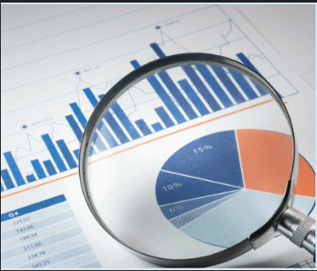
STEPS TO COMPLETE THE DASHBOARD:
DATA DISCOVERY:
In this step we are finding the useful data for analysis of sales insights of the company by using MYSQL.
The analysis based on:
Tracking revenue numbers and sales insights year over year
Revenue break down by regian by different products
Tracking the revenue trends etc…

Slide 6

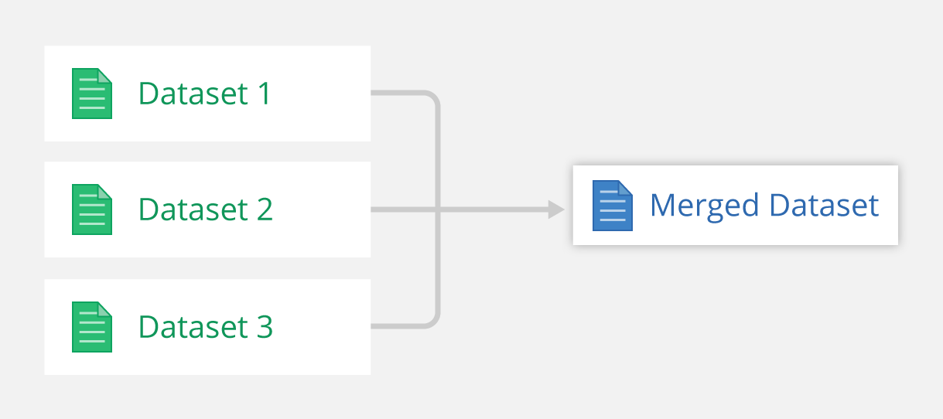
DATA CLEANING AND MERGING:
Data cleaning is the process of fixing or removing incorrect, corrupted, incorrectly formatted, duplicate, or incomplete data within a dataset(dataset is analyzed data created by MYSQL) by using POWER QUREY EDITOR(it is inbuilt in POWER BI).
After cleaning we are finding the relationships.
After we are merging the data based on relationships

Slide 7
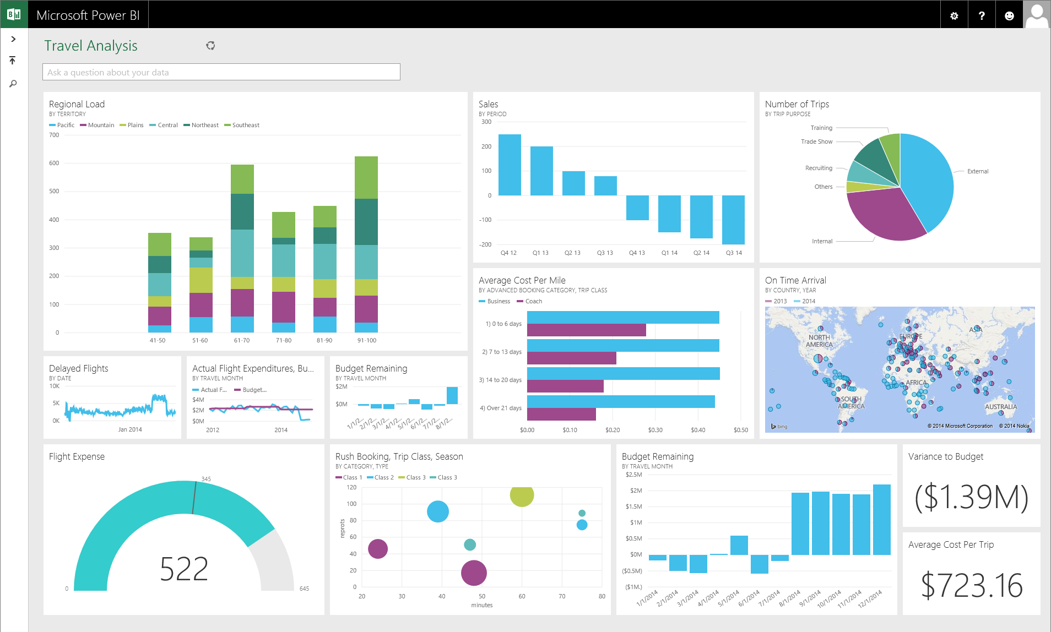
GENERATING THE DASHBOARDS:
Generating the dashboards based on fulfilling the need to know the insigths of the company
The dash board consists of factors influencing the sales of the company
By using this dashboard we can easily understand the sales insights of the company when market is growing in dynamically.

Slide 8

STACKHOLDERS DEPENDS ON DASHBOARD:
Sale director
Marketing team
Customer service team
Data analytics team
It team

Slide 9
THE END

